Slide 1
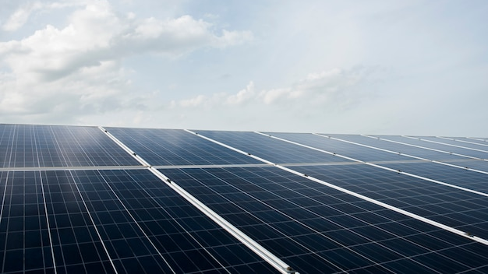
AI-Enhanced Solar Power Harvesting with Dynamic MPPT Control
Optimizing Solar Energy Extraction with AI and IoT Integration
MaxPower Rangers

Slide 2
The Challenge We Address
Growing energy demand and need for sustainable solutions.
Inefficiency in traditional solar power systems due to:
Fluctuating irradiance and temperature.
Suboptimal MPPT (Maximum Power Point Tracking) algorithms.
Limited real-time monitoring and predictive maintenance.

Slide 3

AI-Powered Solar Energy Optimization
Integration of Artificial Intelligence and IoT to enhance MPPT control in solar power systems.
Use of Incremental Conductance (INC) MPPT Algorithm combined with AI for real-time adjustments.
Incorporates real-time irradiance and temperature sensors for duty cycle optimization.
Predictive maintenance for solar panel degradation detection

Slide 4
Innovative Highlights of the System
AI-Assisted MPPT Control: Adjusts duty cycles dynamically for maximum power extraction.
IoT-Based Real-Time Monitoring: Data visualization and remote monitoring.
Predictive Maintenance: Identifies panel decay using historical power output trends.
Energy Efficiency Improvements: Reduces energy losses through optimized switching.

Slide 5
Role of AI in Our System
Algorithm: Multiple Linear Regression for Duty Cycle Prediction.
Inputs: Irradiance and Temperature.
Outputs: Duty Cycle 1 and Duty Cycle 2 for interleaved boost converter.
Performance Metrics:
Mean Squared Error (MSE): 4.99e-07
R-Squared (R²): 99.79%
High Accuracy and Precision (~99%).

Slide 6
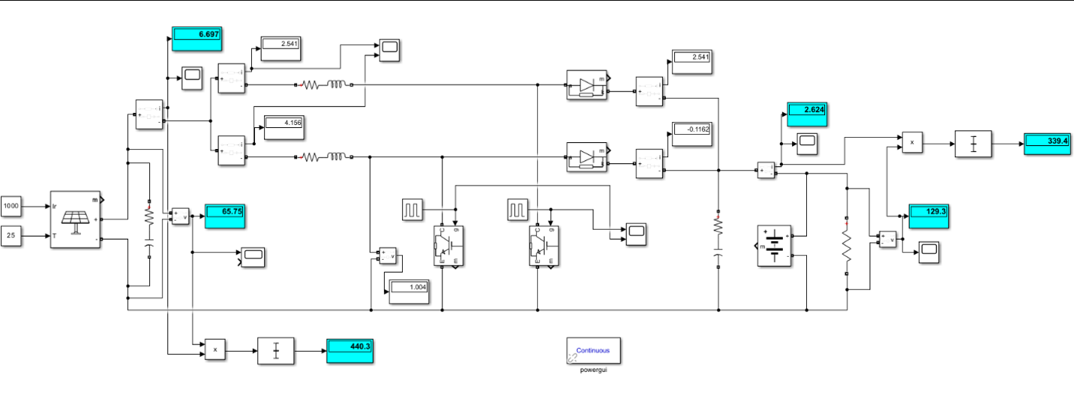
Optimized Hardware Implementation
Interleaved boost converter design:
Snubber Circuit: Minimizes switching losses.
Parallel Switches and Diodes: Reduces voltage drops.
The AI model receives real-time input from irradiance and temperature sensors, enabling it to predict optimal duty cycles dynamically.

Slide 7
Impact and Efficiency Gains
Improved Energy Efficiency: Up to X% increase in solar energy output.
Real-Time Adaptation: Faster response to environmental changes.
Predictive Maintenance: Reduces downtime and maintenance costs.
Visualization: Graphs of efficiency gains, duty cycle behavior, and power output trends.

Slide 8
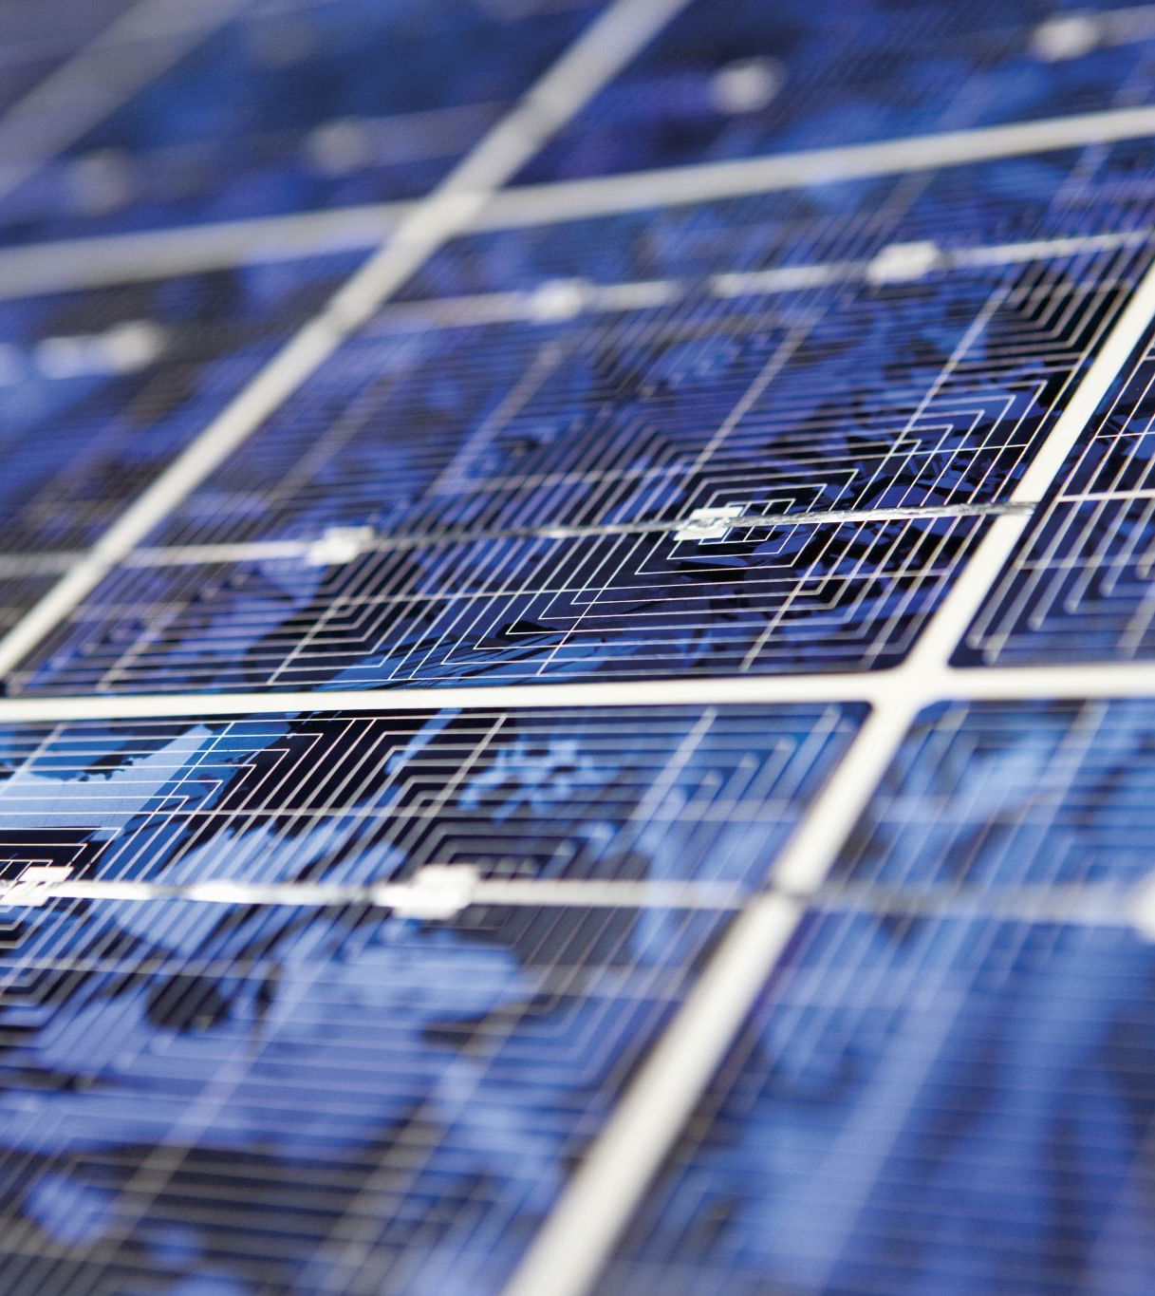
Why Our Solution Stands Out
Scalability: Compatible with small and large solar installations.
Cost-Effectiveness: Efficient energy extraction reduces costs.
Future-Ready: AI-based predictive analytics ensures long-term reliability.
Environmental Impact: Promotes sustainable energy adoption

Slide 9
Expanding the Potential
Integration with Smart Grids for enhanced energy distribution.
Battery Management Systems for solar storage optimization.
Advanced AI Models for improved predictions under diverse conditions.
Global Implementation in solar farms and urban energy systems.

Slide 10
Key Takeaways
A robust solution to improve solar power harvesting using AI and IoT.
Demonstrated high efficiency, accuracy, and predictive capabilities.
Contributing to the global transition toward renewable energy.

Slide 11

Thank you

